Slide 1




Workshop iBio II: Bioinformática
Introducción a RNAseq
Dr. Jonathan Maldonado Dr. Tomás Moyano
jomaldon@gmail.com tcmoyano@uc.cl

Slide 2
Pipeline típico de RNAseq
Assembled
contigs
Transdecoder
Predicted proteins
All raw reads
Quality control
Trimmomatic
Trinity
CD-HIT
Non redundant proteins
BLASTP
Filter and trimmed files
Salmon
Non-plant proteins removal
referencia
Plant and novel proteins
Sample 1
Sample 2
Sample 3
Sample n
Annotated proteins
Reading counting per transcripts
DeSEQ2
Gentileza Bárbara Peña
Genes, Functions, biological process differentially expressed by treatment
Differential expressed genes

Slide 3
El método de RNAseq
Conteo
T
Referencia
Millones de reads
Control
gen1
gen2
gen3
gen4
gen5
…
gen55,564
0
5
7
10
10
…
…
mapeo
Millones de reads
Treated

Slide 4
Conteo
C
Conteo
T
Referencia
Millones de reads
Control
gen1
gen2
gen3
gen4
gen5
…
gen55,564
10
10
7
5
0
…
…
0
5
7
10
10
…
…
mapeo
C
T
gen2
gen3
gen5
Millones de reads
Treated
gen1
gen4

Slide 5
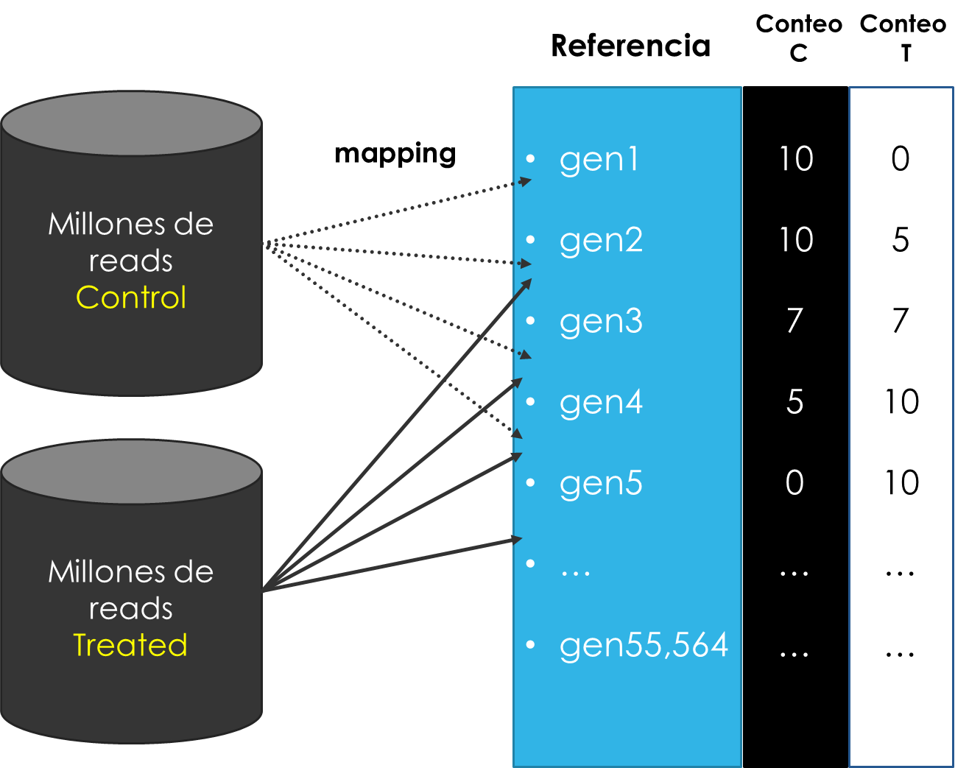
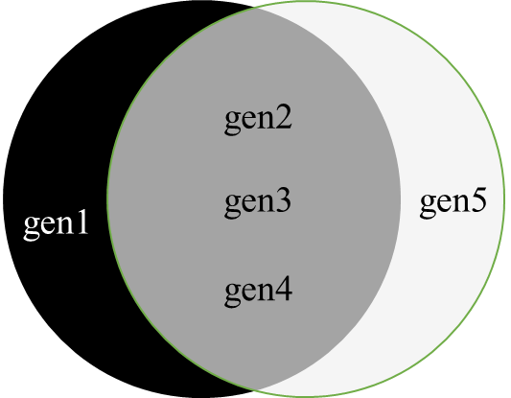
El método de RNAseq
Genes expresados en C
Genes expresados en T
vs
10
Expression level
(RPKM)
5
0
C T C T C T C T C T
gen1 gen2 gen3 gen4 gen5

Slide 6
Tipos de archivos que usaremos
FASTA
FASTQ
SAM
BAM

Slide 7
Archivos FASTA
cat SRR1811524_1M.fasta | head -n 12
>SRR1811524.2 HWI-ST615:645:H7P8JADXX:1:1101:1414:2351/1
CTTAGCTTGTCGAAACAACATCCAAGAGTTCATGCTTAACCAACTCGGAAT
>SRR1811524.3 HWI-ST615:645:H7P8JADXX:1:1101:1416:2377/1
CCGACTTGTTCTGCGTATCTAGACTAACTCTGGTTTCCCTCTTAGACAAAG
>SRR1811524.4 HWI-ST615:645:H7P8JADXX:1:1101:1479:2437/1
CAAACACTTTCCAGGATACCACTCAATCTCCGTCCCGAGGGCCTTCTCAAG
cat SRR1811524_1M.qual | head -n 12
>SRR1811524.2 HWI-ST615:645:H7P8JADXX:1:1101:1414:2351/1
5 10 15 20 30 40 40 40 40 40 40 40 40 40 40 40 40 40 40 404 04 04 040 40 40 40 40 40 40 30 20 10 5
>SRR1811524.3 HWI-ST615:645:H7P8JADXX:1:1101:1416:2377/1
5 10 15 20 30 40 40 40 40 40 40 40 40 40 40 40 40 40 40 404 04 04 040 40 40 40 40 40 40 30 20 10 5
>SRR1811524.4 HWI-ST615:645:H7P8JADXX:1:1101:1479:2437/1
5 10 15 20 30 40 40 40 40 40 40 40 40 40 40 40 40 40 40 404 04 04 040 40 40 40 40 40 40 30 20 10 5

Slide 8
Archivos FASTA
cat SRR1811524_1M.fasta | head -n 12
>SRR1811524.2 HWI-ST615:645:H7P8JADXX:1:1101:1414:2351/1
CTTAGCTTGTCGAAACAACATCCAAGAGTTCATGCTTAACCAACTCGGAAT
>SRR1811524.3 HWI-ST615:645:H7P8JADXX:1:1101:1416:2377/1
CCGACTTGTTCTGCGTATCTAGACTAACTCTGGTTTCCCTCTTAGACAAAG
>SRR1811524.4 HWI-ST615:645:H7P8JADXX:1:1101:1479:2437/1
CAAACACTTTCCAGGATACCACTCAATCTCCGTCCCGAGGGCCTTCTCAAG
identificador
secuencia
cat SRR1811524_1M.qual | head -n 12
>SRR1811524.2 HWI-ST615:645:H7P8JADXX:1:1101:1414:2351/1
5 10 15 20 30 40 40 40 40 40 40 40 40 40 40 40 40 40 40 404 04 04 040 40 40 40 40 40 40 30 20 10 5
>SRR1811524.3 HWI-ST615:645:H7P8JADXX:1:1101:1416:2377/1
5 10 15 20 30 40 40 40 40 40 40 40 40 40 40 40 40 40 40 404 04 04 040 40 40 40 40 40 40 30 20 10 5
>SRR1811524.4 HWI-ST615:645:H7P8JADXX:1:1101:1479:2437/1
5 10 15 20 30 40 40 40 40 40 40 40 40 40 40 40 40 40 40 404 04 04 040 40 40 40 40 40 40 30 20 10 5
identificador
calidad

Slide 9
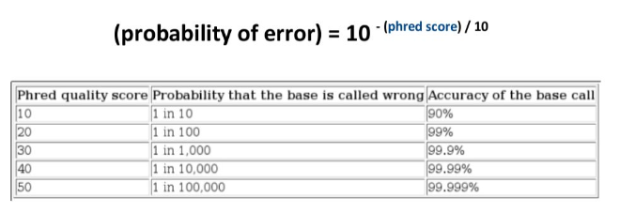
cat SRR1811524_1M.qual | head -n 12
>SRR1811524.2 HWI-ST615:645:H7P8JADXX:1:1101:1414:2351/1
5 10 15 20 30 40 40 40 40 40 40 40 40 40 40 40 40 40 40 404 04 04 040 40 40 40 40 40 40 30 20 10 5
>SRR1811524.3 HWI-ST615:645:H7P8JADXX:1:1101:1416:2377/1
5 10 15 20 30 40 40 40 40 40 40 40 40 40 40 40 40 40 40 404 04 04 040 40 40 40 40 40 40 30 20 10 5
>SRR1811524.4 HWI-ST615:645:H7P8JADXX:1:1101:1479:2437/1
5 10 15 20 30 40 40 40 40 40 40 40 40 40 40 40 40 40 40 404 04 04 040 40 40 40 40 40 40 30 20 10 5
identificador
calidad
Codificación
!"#$%&'()*+,-./0123456789:;<=>?@ABCDEFGHIJKLMNOPQRSTUVWXYZ[\]^_`abcdefghijklmnopqrstuvwxyz{|}~
0 1 2 3 .. 93

Slide 10
Archivos FASTQ
zcat SRR1811524_1M.fastq.gz | head -n 12
@SRR1811524.1 HWI-ST615:645:H7P8JADXX:1:1101:1015:2373/1
NAACACTCAACTTGAACGCAATGAACCAGGCACCAAACCCATGGCACGTGT
+
#4BDFFFFHHHHHIJJJJJJJJJJJJJIJJJJJIJJHIJJIJJIIGIJJAH
@SRR1811524.2 HWI-ST615:645:H7P8JADXX:1:1101:1414:2351/1
CTTAGCTTGTCGAAACAACATCCAAGAGTTCATGCTTAACCAACTCGGAAT
+
CCCFFFFFHFHHAHHIIIIEHIGIIHIIIIGEEIIIIEGGIGHIEFHGIIG
@SRR1811524.3 HWI-ST615:645:H7P8JADXX:1:1101:1416:2377/1
CCGACTTGTTCTGCGTATCTAGACTAACTCTGGTTTCCCTCTTAGACAAAG
+
@??DD?DDHFDF?GEEHIIJJEHEHIIAFHFHCGGGCBF@HGI@?FBDGED
...

Slide 11
Archivos FASTQ
zcat SRR1811524_1M.fastq.gz | head -n 12
@SRR1811524.1 HWI-ST615:645:H7P8JADXX:1:1101:1015:2373/1
NAACACTCAACTTGAACGCAATGAACCAGGCACCAAACCCATGGCACGTGT
+
#4BDFFFFHHHHHIJJJJJJJJJJJJJIJJJJJIJJHIJJIJJIIGIJJAH
@SRR1811524.2 HWI-ST615:645:H7P8JADXX:1:1101:1414:2351/1
CTTAGCTTGTCGAAACAACATCCAAGAGTTCATGCTTAACCAACTCGGAAT
+
CCCFFFFFHFHHAHHIIIIEHIGIIHIIIIGEEIIIIEGGIGHIEFHGIIG
@SRR1811524.3 HWI-ST615:645:H7P8JADXX:1:1101:1416:2377/1
CCGACTTGTTCTGCGTATCTAGACTAACTCTGGTTTCCCTCTTAGACAAAG
+
@??DD?DDHFDF?GEEHIIJJEHEHIIAFHFHCGGGCBF@HGI@?FBDGED
...
identificador
secuencia
separador
calidad

Slide 12
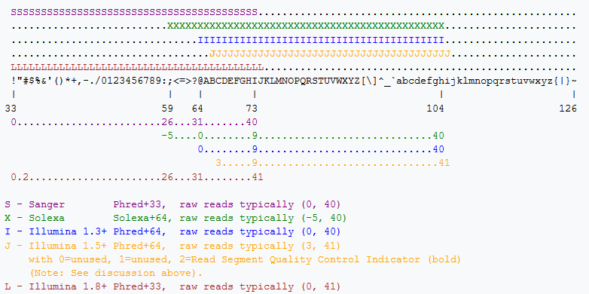
Codificación de calidad
https://en.wikipedia.org/wiki/FASTQ_format

Slide 13
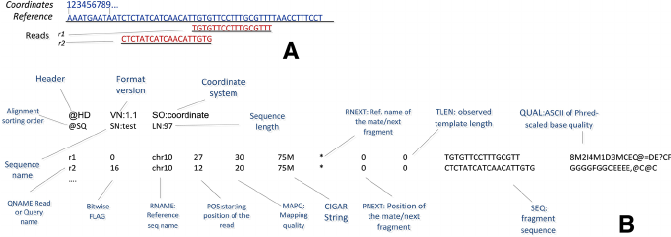
Archivos SAM (Sequence Alignment Map)
@HD VN:1.0 SO:unsorted
@SQ SN:test_ref LN:17637
SRR1524970.144283 16 test_ref 1706 255 25M * 0 0 TGCTGATGAAGCAGAACAACTTTAA ]YG[^baaaa^W`ab]]````aaba AS:i:0 XN:i:0 XM:i:0 XO:i:0 XG:i:0 NM:i:0 MD:Z:25 YT:Z:UU
SRR1524970.316478 16 test_ref 1706 255 24M * 0 0 TGCTGATGAAGCAGAACAACTTTA `\X_`aaaaaY]``b_aa_aaaaa AS:i:0 XN:i:0 XM:i:0 XO:i:0 XG:i:0 NM:i:0 MD:Z:24 YT:Z:UU
https://en.wikipedia.org/wiki/SAM_(file_format)

Slide 14
FIN

